Slide 1
Cognos SQL Debugging
Bryan Mack
06-10-2013

Slide 2
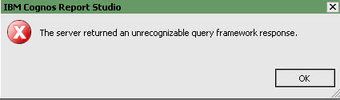
Congos SQL Debugging
Cognos uses its own compiler, so while SQL may execute in SQL Developer, it will not necessarily do so in Cognos.
This is irritating as you get this not-so-informative error message:

Slide 3
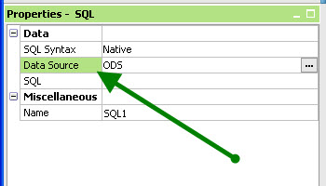
Basic things to check
Has your Cognos connection timed out?
Did you set the query’s data source to ODS?

Slide 4
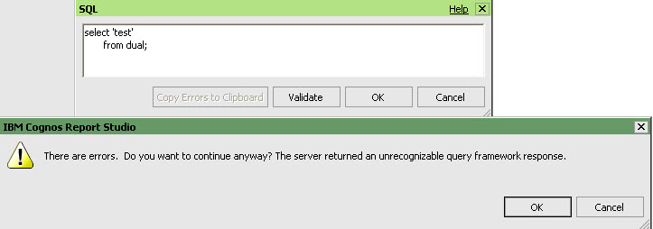
Inconsistencies between Cognos & Oracle
Semi-colon cannot be used to end SQL statement in Cognos

Slide 5
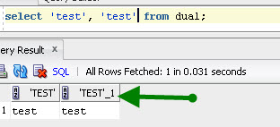
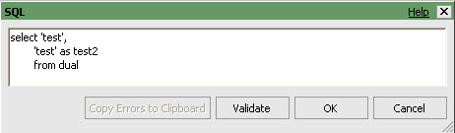
Inconsistencies between Cognos & Oracle
In Oracle, you can repeat a column name and it will amend it with a # at the end of the column name:
Cognos won’t play this nicely. You need to alias the column names for this to work.

Slide 6
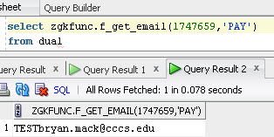
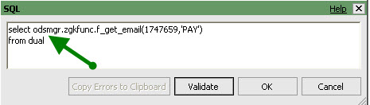
Inconsistencies between Cognos & Oracle
Must fully-qualify packages
Oracle
Cognos

Slide 7
Comments in weird places
I can’t find a full pattern to this, but sometimes Cognos freaks out if you put a comment in a weird place.
Of course, I tried a plethora of combinations in making this powerpoint and could get none to fail. That’s the way it works when you can’t find a pattern!

Slide 8
VPDI Filter
This one has bit me a couple of times. You cannot use capital letters in the VPDI filter.
SQL Developer may be set to capitalize keywords (Tools -> Preferences -> Code Editor -> Completion Insight)
This issue may be fixed in Cognos 10.2

